Slide 1


Slide 2

Bike Sharing Demands
OR 568-004: Applied Predictive Analytics
George Mason University
Dr. Vadim Sokolov

Slide 3
Meet the Team:
Amy Lovas
Hannah Abraham
Kyle Smith
Sagar Goswami

Slide 4
Detailed Table of Contents
Introduction – Amy
Brief overview of dataset
Project Objectives/Goals - Amy
Key questions
Overarching goal
Methods – Sagar, Kyle, Hannah
How did we get to the solutions for our questions
Question 1
EDAs: Sagar, Hannah
Question 2
Linear regression: Hannah
Rf, bagging, boosting: Kyle
Deep learning: Sagar
Ensemble?: Kyle
Question 3 & 4
Hypothesis testing: Amy
Findings/Results – Sagar, Kyle, Hannah, Amy
Findings - Amy
Which model works best
Go into more depth about correlations, and different variables
Recommended solutions – Kyle/Hannah
What models bike sharing company can use to predict bike rental counts
Price fluctuations based on our findings – Kyle/Hannah
What variables to use to determine price fluctuations

Slide 5

Agenda
Introduction
Project Goals
Data Exploration
Predictive Models
Findings
Recommendations

Slide 6

Introduction

Slide 7
Introduction
Variable | Data Type
Date: Year-Month – Day | Date
Rented Bike Count – By Hour | Integer
Hour of the day – 24 Hour Clock | Integer
Temperature – Degrees Celsius | Float
Humidity - % | Integer
Windspeed – m/s | Float
Visibility – 10m | Integer
Dew Point Temperature – Degrees Celsius | Float
Solar Radiation – MJ/m2 | Integer
Rainfall – mm | Float
Snowfall – cm | Float
Season – Winter, Spring, Summer, Autumn | Text (Categorical)
Holiday – Holiday/No Holiday | Binary
Functional Day – Workday/Non-Workday | Binary
Contains 8760 observations of bike sharing demand for 2017-2018 in Seoul, South Korea
Each observation has 14 variables:

Slide 8

Project Goals

Slide 9

Project Goals
Objective: Create predictive models that can be used by the bike sharing company to maintain enough supply of bikes to meet anticipated demand and plan a better resource allocation strategy.
Key Questions:
1. What features can bike share companies use to create a dynamic pricing model to monitor bike demands?
2. What are the bike-sharing trends among the public in Seoul?
3. Is bike sharing more popular during holidays?
4. Does weather effect the demand for bike sharing?

Slide 10

Data Exploration

Slide 11
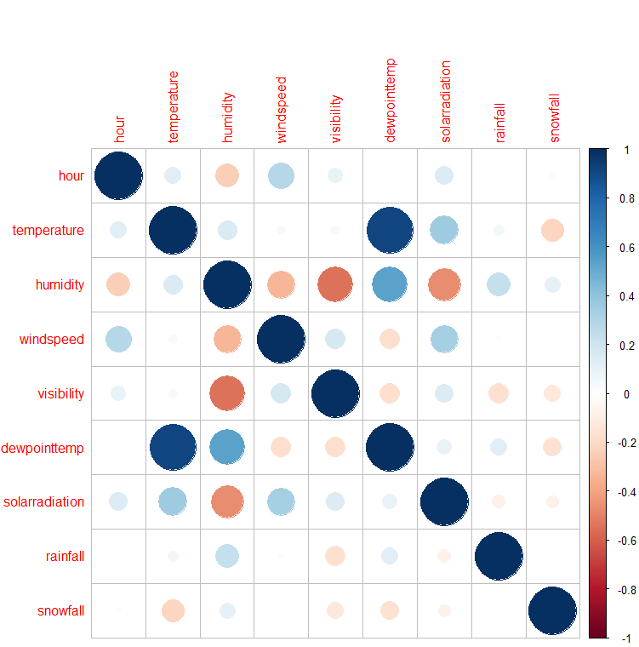
Correlation Plot

Slide 12
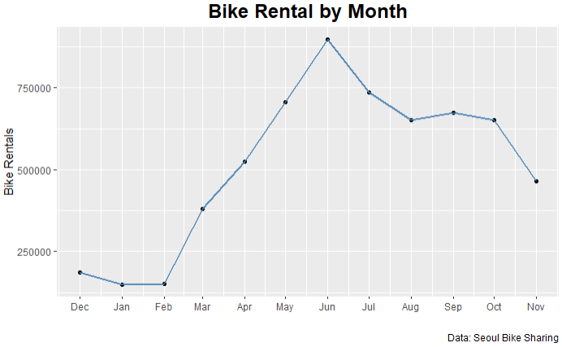
Bike Rentals by Month

Slide 13
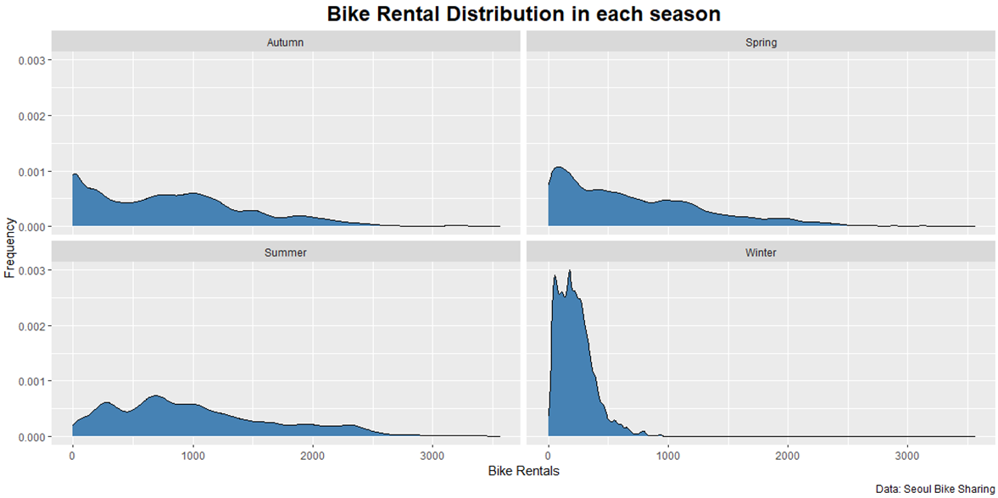
Bike Rental by Season

Slide 14
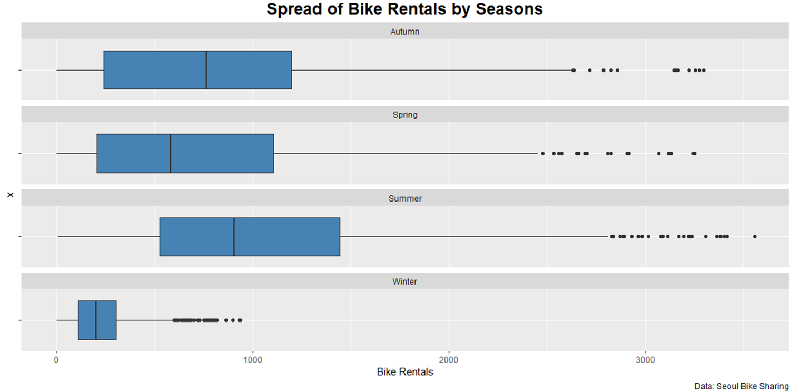
Bike Rentals by Season

Slide 15
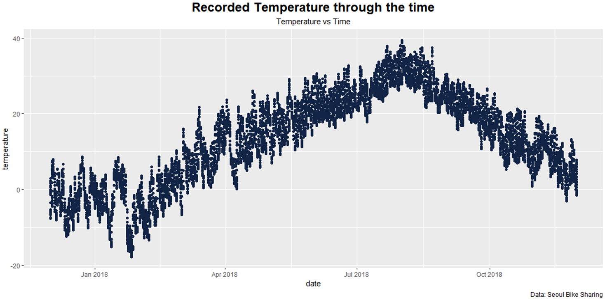
Bike Rental by Temperature

Slide 16
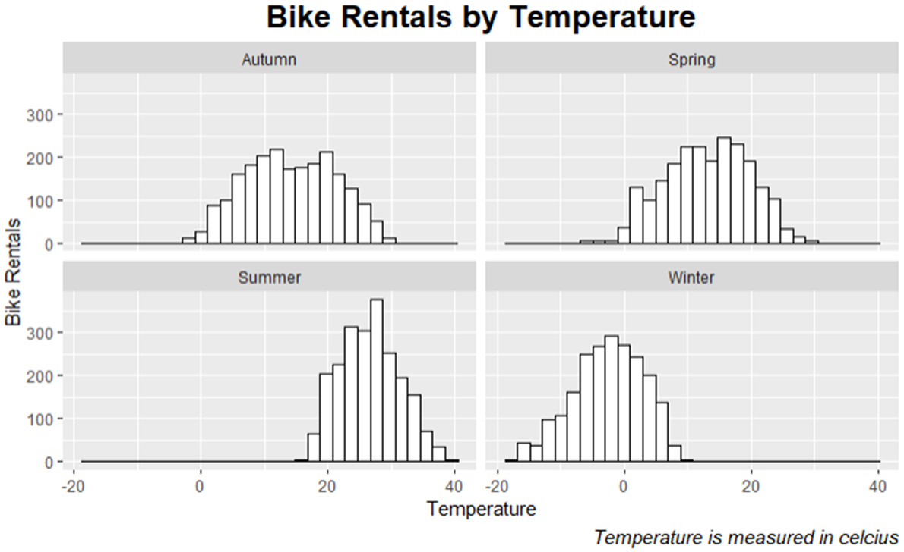
Bike Rentals by Temperature

Slide 17
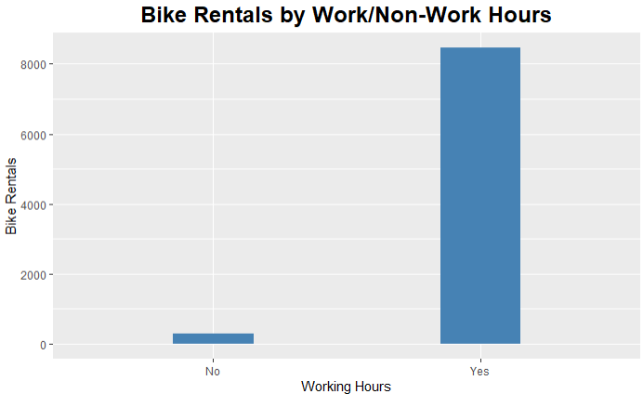
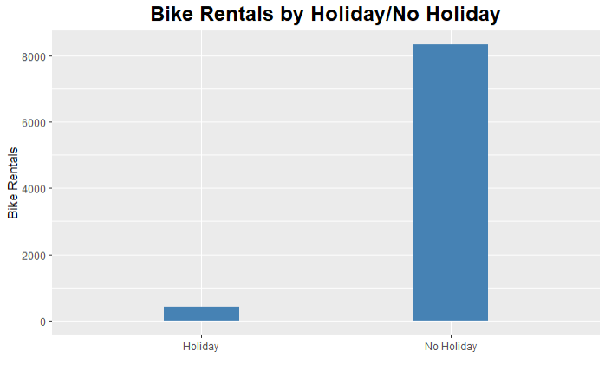
Bike Rentals by Occasion

Slide 18

Predictions
Bike Rental Predictions

Slide 19
Predictive Models
Linear Regression
Ensemble Models
Deep learning
Combined Model
Hypothesis Testing

Slide 20
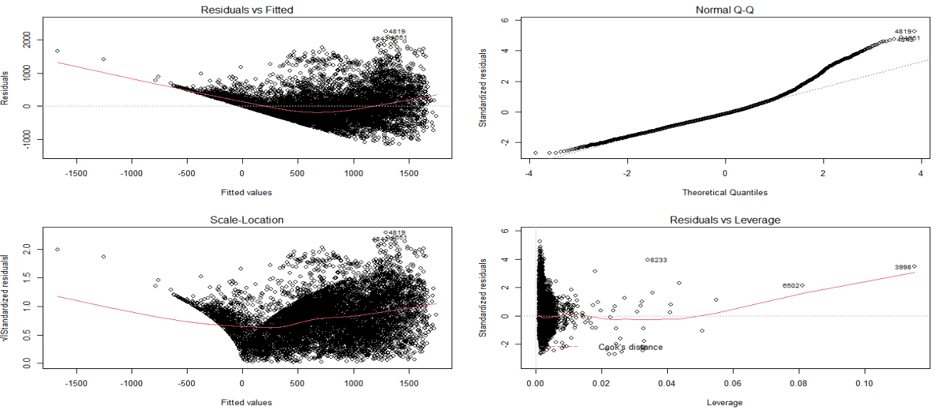
Linear Regression
Linear model before log transformation

Slide 21
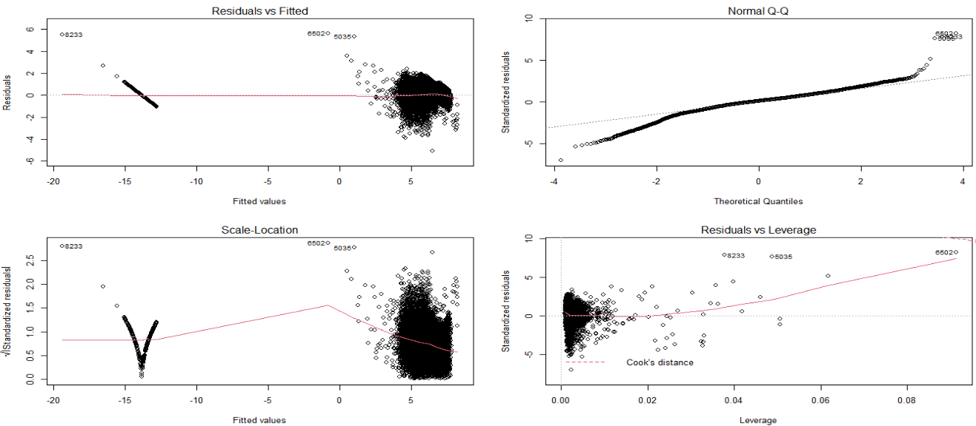
Linear Regression
Linear model after log transformation

Slide 22
Linear Regression (cont.)
Feature selection methods:
Best Subset Selection
Model with 15 variable produces the best model
Variables removed:
Visibility
Snowfall
Dewpoint temperature
Month
Day of the year
Day of the month
Models with 13 and 17 variables produces the best model
Cross validation (k=5)

Slide 23
Predictive Models
Linear Regression
Ensemble Models
Deep learning
Combined Model
Hypothesis Testing

Slide 24
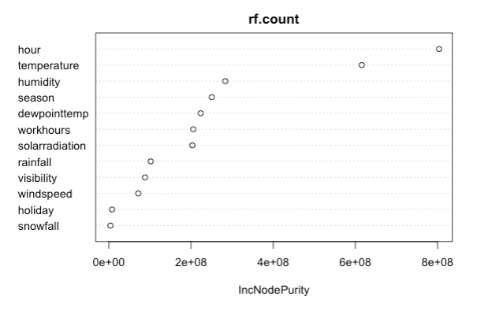
Ensemble Models
Random forest
Boosting
Bagging

Slide 25
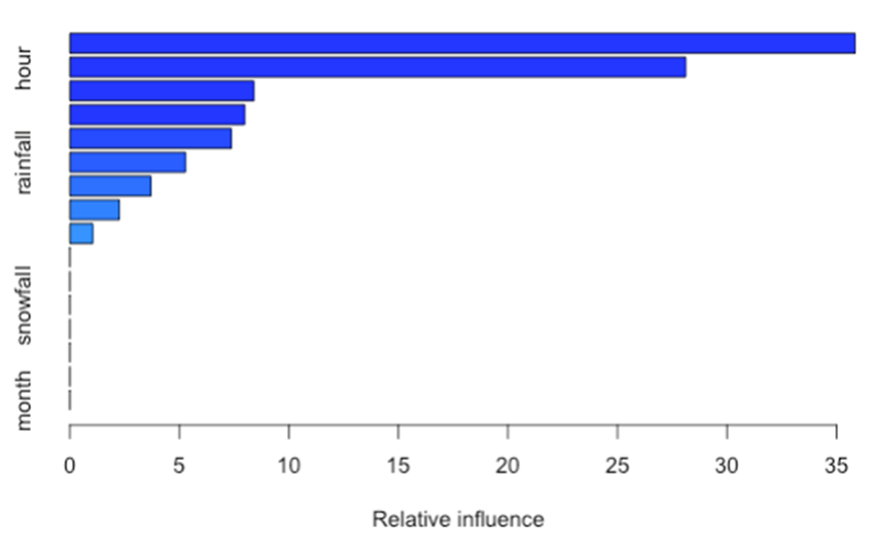
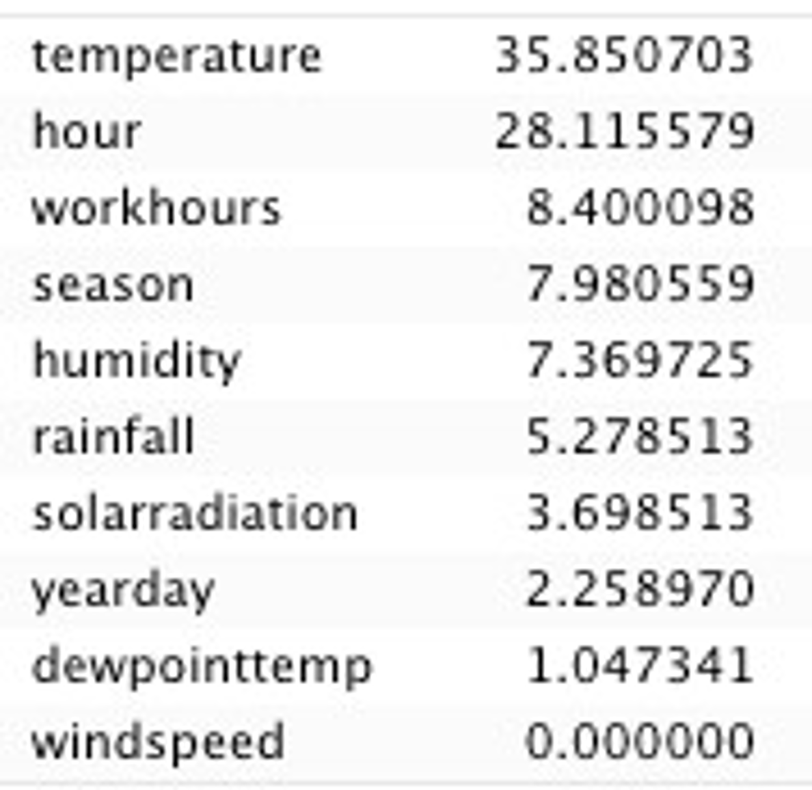
Ensemble Methods: Boosting

Slide 26
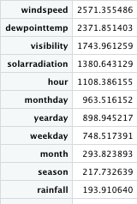
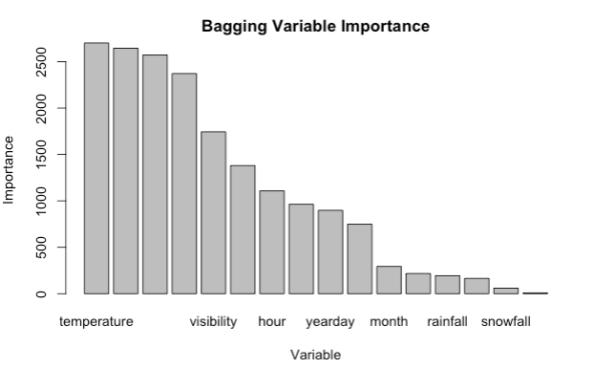
Ensemble Methods: Bagging

Slide 27
Predictive Models
Linear Regression
Ensemble Models
Deep learning
Combined Model
Hypothesis Testing

Slide 28
Deep Learning (Procedure)
Data Preparation
Type Conversion
Data Cleaning
Data Extraction
Data Preprocessing
Data Encoding
Data Vectorization
Split Data
Model Assembly
#of Layers, #of Nodes
Activation
Optimizers
Loss Function
Model Evaluation
Test Losses
Validation Curves

Slide 29
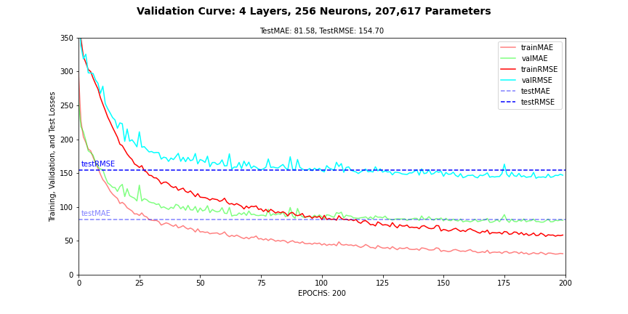
Deep Learning (Model)
Best Model so far from the Hyperparameter Tuning
Test/Val RMSE levels out at roughly 150/75
Indicates over-fitting, Model biased towards training data.
Lots of ways to improve this model further.

Slide 30
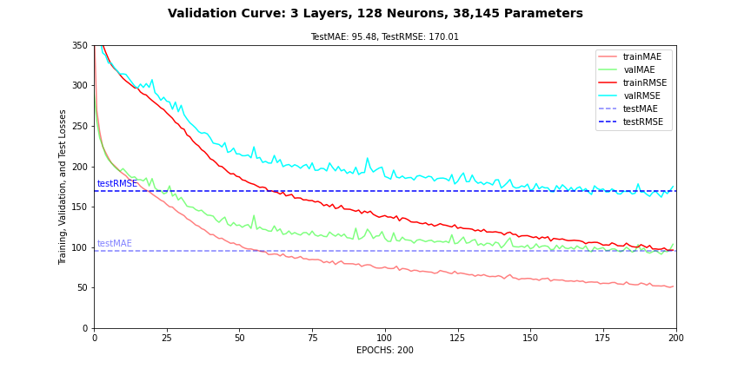
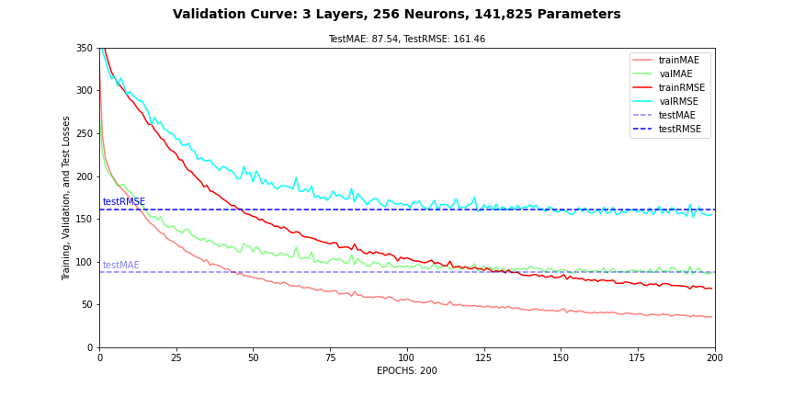
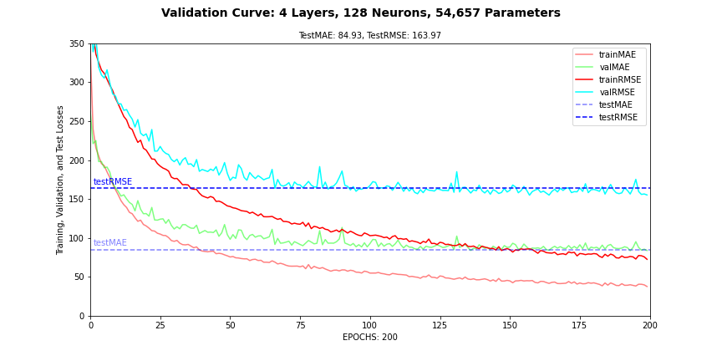
Deep Learning (HPT)

Slide 31
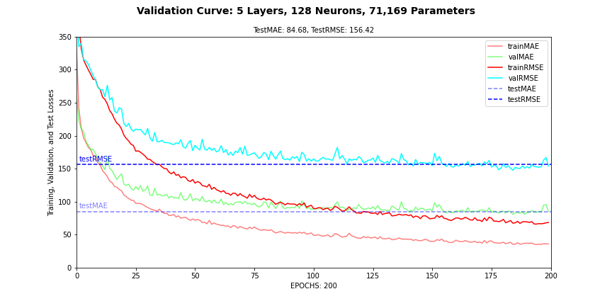
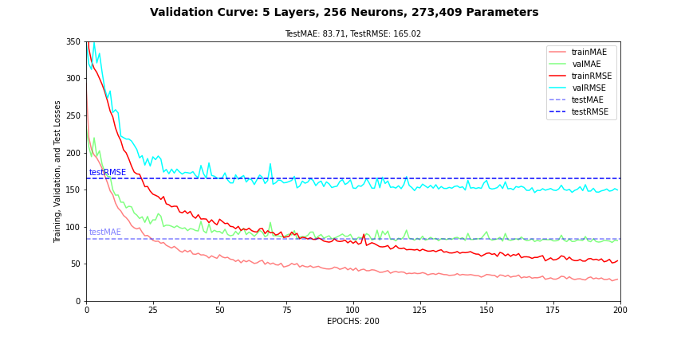
Deep Learning (HPT)

Slide 32
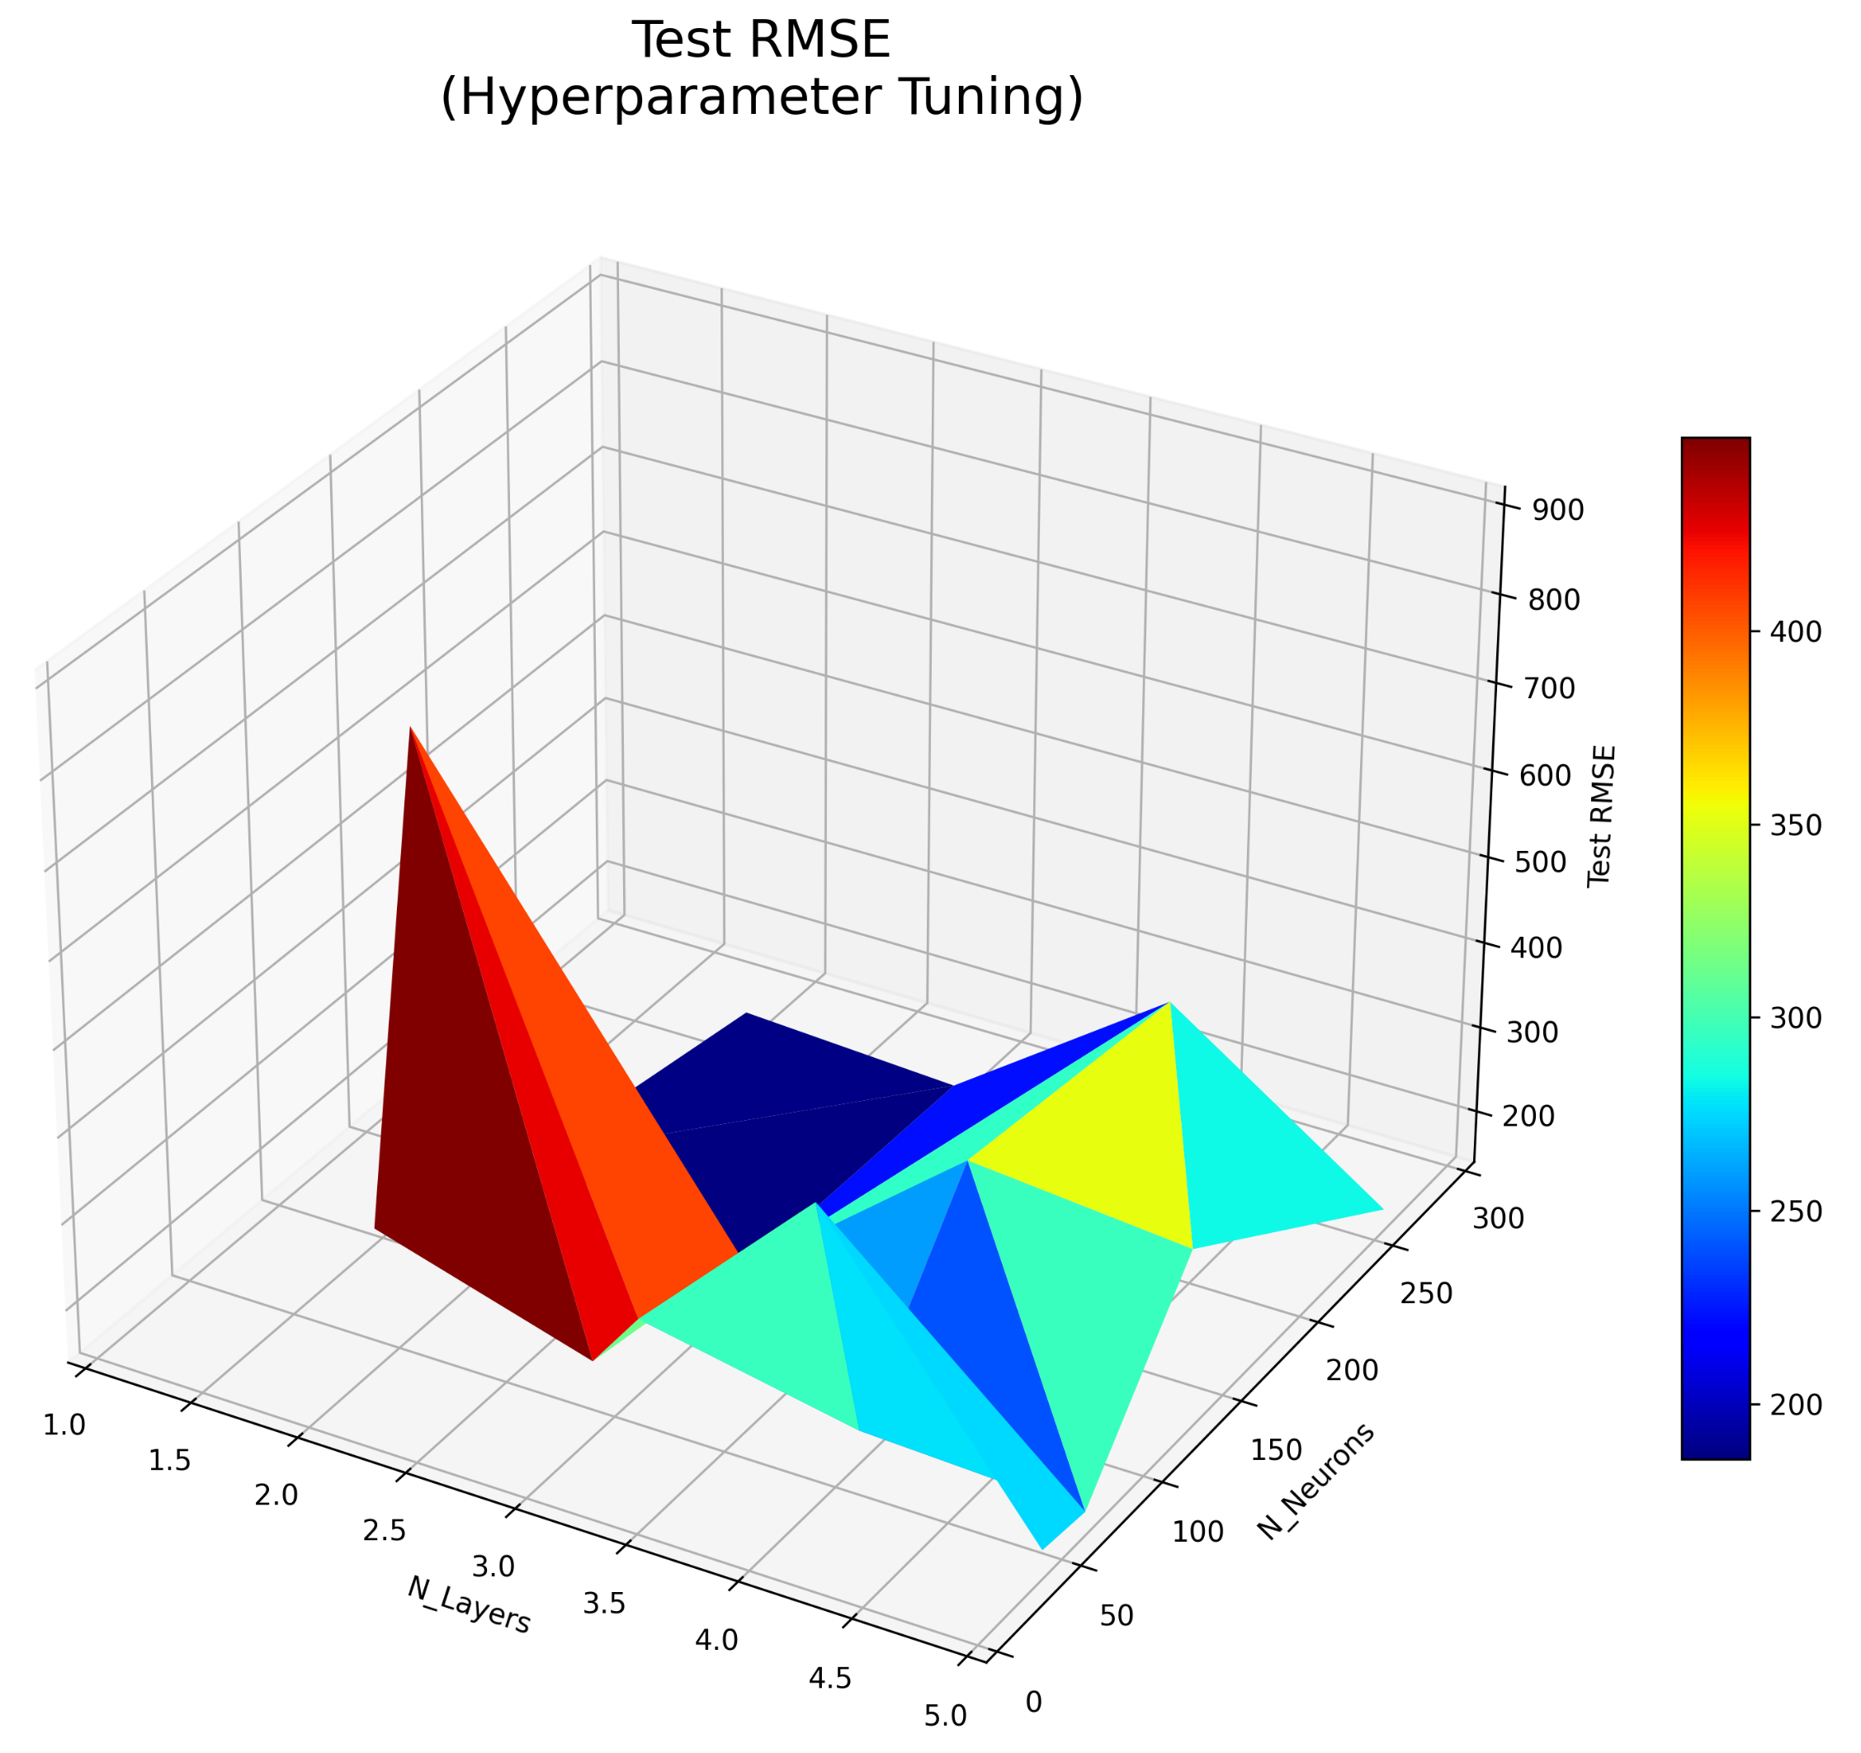
Deep Learning (HPT)

Slide 33
Deep Learning (Improvements)
Improve the training speed. (Faster training, more experiments, better models)
Create a tensorflow-pipeline using tf.data.Dataset classes
Convert data to TFRecords to train models on TPUs.
Try different combinations of layers with varying #of Nodes, Activations, and Dropouts
Identify and remove outliers, try different repartitions, retrain the models.
Train for even higher Epochs (explore possibilities for convergence in further iterations)
Experiment with unique combinations of layer nodes.

Slide 34
Predictive Models
Linear Regression
Ensemble Models
Deep learning
Combined Model
Hypothesis Testing

Slide 35
Combination Model
Linear combination of the outcome of all models
Difficult to interpret feature importance, etc.
Takes multiple linear model, random forest, boosting, and bagging results
Weights determined based on model's solo performance

Slide 36
Predictive Models
Linear Regression
Ensemble Models
Deep learning
Combined Model
Hypothesis Testing

Slide 37
Hypothesis Testing: Holidays
Is bike sharing more popular during the holidays?
Test the null hypothesis vs the alternative hypothesis:
H₀: There is no difference in mean bike count between holidays and not holidays
H_{a}: There is a difference in mean bike count between holidays and not holidays
Welch’s Two Sample T-Test Shows:
t = 7.6 Degrees of Freedom: 490 p-value: 1.52e⁻¹³
95% Confidence Interval: (159.8, 271.3)
Mean bike count for not holidays: 715.3
Mean bike count for holidays: 499.8
Conclusion: We reject the null hypothesis in favor of the alternative hypothesis and conclude that bike renting is more popular on non-holidays.

Slide 38
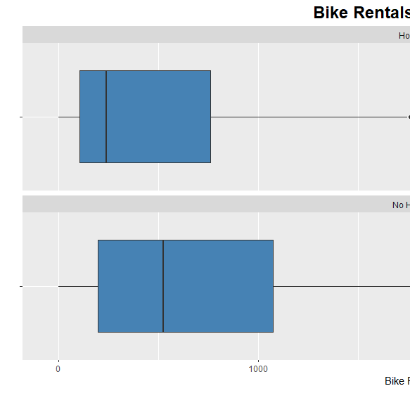
Hypothesis Testing: Holidays (cont.)

Slide 39
Hypothesis Testing: Weather
Does weather (hot vs cold) effect bike sharing demand?
Test the null hypothesis vs the alternative hypothesis:
H₀: There is no difference in mean bike count between hot (summer) and cold (winter) weather seasons
H_{a}: There is a difference in mean bike count between hot (summer) and cold (winter) weather seasons
Welch’s Two Sample T-Test Shows:
t = 53.8 Degrees of Freedom: 2420 p-value: 2.2e⁻¹⁶
95% Confidence Interval: (779, 838)
Mean bike count for hot weather (summer): 1034.1
Mean bike count for cold weather (winter): 225.5
Conclusion: We reject the null hypothesis in favor of the alternative hypothesis and conclude that bike renting is more in hot weather than in cold weather seasons.

Slide 40
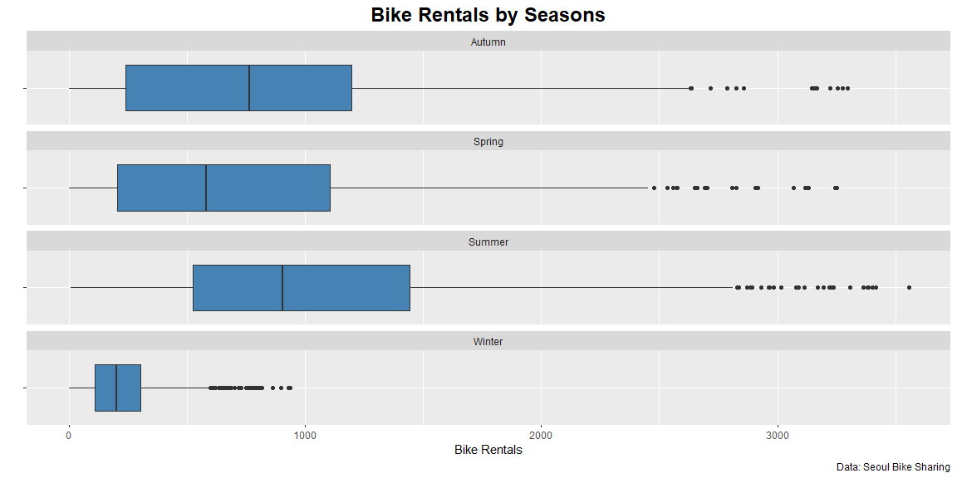
Hypothesis Testing: Weather (cont.)

Slide 41

Findings

Slide 42

Bike Sharing Trends
Most popular month for bike rentals are during warmer months
May, June and July has the highest bike rental counts in 2018
Increase bike rentals during work hours and when there's no holiday

Slide 43
Model Performance

Slide 44
Recommendations
Which models to use
Create a dynamic pricing model according to significant features:
Season
Hour
Temperature
Humidity
Future work
Multiple years of data to incorporate time-series prediction

Slide 45

Q&A

Slide 46

Thank You !!
Thank you for listening!

